Slide 1

Getting started with Data Science
Data Science

Slide 2
Introduction to data
At the end of this chapter, you will understand what is data. You will know:
What are qualitative and quantitative data?
Difference between discrete and continuous data
Real world applications of data

Slide 3

Chapter 1: What is data?
We often use the term data to refer to computer information
This information is either transmitted or stored
Data comes in numerous forms
Any kind of information may it be in numbers or text, or pictures is termed as Data

Slide 4

Types of data
Data comes in different types. Some of the common types of data include:
Text
Image
Video
Numbers
Spreadsheets
Sound

Slide 5
Qualitative vs Quantitative data
Qualitative
Qualitative data is the data that is a descriptive piece of information.
For example, "What a nice day it is"
Quantitative
Quantitative Data is the data that is numerical information
For example, “1”, “3.65” etc.

Slide 6
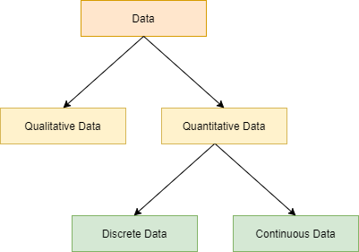
Quantitative data can be of two types

Slide 7
Discrete vs Continuous data
Discrete
Can be expressed as a specific value.
For example, “Number of months in a year“, “Number of members in a family” etc.
Continuous
Can be any value in an interval
For example, “The amount of oxygen in the atmosphere”, “Age of members in a family”

Slide 8
Real world applications of data
Predicting interests of the audience on different online video streaming platforms
Getting insights from customer reviews in online stores, food delivery apps etc.
Effective targeting of the advertisements
Notes:
These are some applications of data. Teachers can explain various other examples.

Slide 9
What is data science?
Extracting meaningful insights from data is known as data science.
Data when investigated and carefully analyzed, provides insights which enriches our daily lives

Slide 10
Careers in data science?
Learning data science offers multiple career options. Some of the common job titles for data scientists include
Data Scientist
Business Intelligence Analyst
Data Mining Engineer
Data Architect
Senior Data Scientist

Slide 11
Careers in data science?
Data Scientist
Data Scientists are data enthusiasts who gather and analyze large sets of structured and unstructured data. They analyze, process, and model data and later interpret the results to create actionable plans for companies and organizations.
Business Intelligence Analyst
Business Intelligence Analysts use data to assess the market and find the latest business trends in the industry. This helps to develop a clearer picture of how a company should shape its strategy.
Data Engineer
Data Engineer examines not only the Data for their own business but also that of third parties. In addition to mining data, a data engineer creates robust algorithms to help analyze the data further.
Data Architect
Senior Data Scientist
Data Architects work closely with users, system designers, and developers to create a blueprint that data management systems use to centralize, integrate and maintain the data sources.
Senior Data Scientists anticipate the business's needs in the future. Although they might not be involved in gathering data, they play a high-level role in analyzing it.

Slide 12

How data science helps us?
Simply stated, data science helps us answer different types of questions from data. Some common questions to ask from data are:
Which class does this belong to - A or B?
Is this an outlier?
What should be done now?

Slide 13
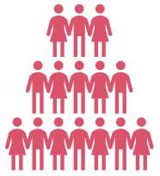
Which class does this belong to - A or B?
The answers to some questions can only be from a definite number of options.
For example,
Q: Will it rain today?
A: Yes/No
Q: Will the weather be hot or cold?
A: Hot/Cold
To make such predictions, we use a family of algorithms called classification algorithms.

Slide 14
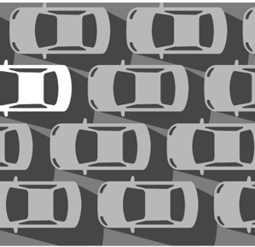
Is this an outlier?
In some cases, the objective is to find outliers or anomalies in data that is otherwise mostly consistent. Some examples of anomaly detections are:
Q: Is this email normal or spam?
Q: You are checking your car tyre pressure. Is the reading normal?
The algorithms that are used for these types of questions are called anomaly detection algorithms.

Slide 15

What will probably be the value of this variable?
There are scenarios in which we must predict numerical values of a variable based on historic data. Some examples are:
Q: How much rainfall will we receive this year?
A: 100 mm
Q: How many runs will the winning team score?
A: 320
The kind of algorithms that can predict these values are called regression algorithms.

Slide 16

What should be done now?
This question usually solves the problems of autonomous robots or self-driving cars that need to make decisions based on changes in external factors. Machine learning helps to solve such problems with the help of reinforcement learning.

Slide 17
Data visualization
Data visualization is the representation of data or information in a graph, chart, or other visual formats
The goal of data visualization is to communicate information clearly and efficiently to users.
Provides a way to see and understand trends, outliers, and patterns in data.

Slide 18
Common types of data visualizations?
Common types of data visualizations are:
Charts
Graphs
Tables
Maps
Histograms

Slide 19
Data visualization using Pie chart
When visualized using Pie Charts it will look like below
Let us consider, we have the food item preference of 50 students.
Food item | Number of students
Pizza | 25
Pasta | 10
Dosa | 15
Notes:
At the end of this chapter, we have a fun activity for the students.

Slide 20
Data visualization using Line chart
When visualized using Line Chart it will look like below
Below data shows the number of students present in the class for one week.
Date | Number of students present
06-Apr | 49
07-Apr | 42
08-Apr | 37
09-Apr | 48
10-Apr | 43
11-Apr | 36
12-Apr | 50
Notes:
At the end of this chapter, we have a fun activity for the students.

Slide 21
Data visualization using Bar chart
When visualized using Bar Chart it will look like below
Below data shows the number of students present in the class for one week.
Date | Number of students present
06-Apr | 49
07-Apr | 42
08-Apr | 37
09-Apr | 48
10-Apr | 43
11-Apr | 36
12-Apr | 50
Notes:
At the end of this chapter, we have a fun activity for the students.

Slide 22
Pre-requisites for data collection
Quality of the Data
Completeness of data
Format of data

Slide 23

Asking the right question?
What exactly do you want to find out?
Which statistical analysis techniques do you want to apply?
Classification
Anomaly detection
Regression
Who are the final users of your analysis results?
What data visualizations should you choose?

Slide 24
Some applications of data science
Data science and AI
Digital Advertisements
Speech Recognition

Slide 25

What is text analytics?
Text analytics can be defined as the process of collecting unstructured text from various sources and analyzing and extracting relevant information from it. It can also be used for transforming it into structured information that can then be used in various other ways.
Notes:
At the end of this chapter, we have a fun activity for the students.

Slide 26

Analytics on image data
Image recognition can be described as a process by which we can process images for identifying people, patterns, logos, objects, or places.
Notes:
At the end of this chapter, we have a fun activity for the students.

Slide 27
Thank You

